Slide 1
Using shadow prices in a linear programing representation of Kanban system dynamics to maximize system throughput
George Liberopoulos • Kostas Takoumis • Dimitrios Pandelis
University of Thessaly
Department of Mechanical Engineering
Volos, Greece

Slide 2
Outline
Introduction
Linear Programming representation of kanban system dynamics
Numerical results
Conclusions

Slide 3
Introduction
Mathematical Programing (MP) models of Discrete Event Dynamic Systems (DEDS)
  Shruben, L. W. 2000. Mathematical programming models of discrete event system dynamics. Proc. 2000 Winter Simulation Conf. IEEE, Piscataway, NJ, 381-385.
  Chan, W. K. V., L. Schruben. 2008. Optimization models of discrete-event system dynamics. Oper. Res. 56 (5) 1218-1237.
Idea
  Represent a DEDS by an Event Relationship Graph (ERG)
  Convert ERG to an MP Problem
  Solving the MP Problem ≡ Simulating the DEDS

Slide 4
Introduction
Manufacturing system applications
  Alfieri, A., A. Matta. 2012. Mathematical programming representation of pull controlled single-product serial manufacturing systems. J. Intell Manuf. 23 (1) 23-35.
Advantages of method
  Easy and elegant way to model system dynamics
  Allows the use of efficient well-developed MP algorithms (e.g., Simplex) for DEDS simulation
  Paves the way for exploiting MP theory (e.g., duality) for the detection of structural properties of the system
    Chan, W. K. V., L. W. Schruben. 2003. Properties of discrete-event systems from their mathematical programming representations. Proc. 2003 Winter Simulation Conf. IEEE, Piscataway, NJ, 496-502.
  Paves the way for using MP techniques (e.g., sensitivity analysis) for parameter design and optimization

Slide 5
Introduction
Parameter Optimization using MP representations of DEDS
Gradient-based numerical optimization
  Solve LP problem (≡ simulate system)
  Use shadow prices of the LP solution to compute (sample path) derivative estimates of performance w.r.t. parameters (equivalent to IPA derivative estimation)
  Use derivatives estimates to drive a gradient-based stochastic optimization algorithm
  Suitable for continuous parameters that appear as constants in the LP problem (e.g., service times in a G/G/m queue)
    Chan, W. K. V., L. W. Schruben. 2006. Response gradient estimation using mathematical programming models of discrete-event system sample paths. Proc. 2006 Winter Simulation Conf. IEEE, Piscataway, NJ, 272-278. (G/G/1)
    Chan, W. K. V., N. Closser. 2013. Sensitivity analysis of linear programming formulations for G/G/M queue. Proc. 2013 Winter Simulation Conf. IEEE, Piscataway, NJ, 667-677. (G/G/M)

Slide 6
Introduction
Optimization using MP representations of DEDS (cont’d)
Simulate system and optimize parameters simultaneously
  Suitable for discrete parameters (e.g., buffers sizes in a production line, Kanban levels in a Kanban system)
  Introduce 0/1 variables to represent all possible values of a discrete decision variable (e.g., buffer size, no. of kanbans, etc.)
  LP problem ⟹ MILP problem
  Use LP approximation to the MILP problem
    Matta, A. 2008. Simulation optimization with mathematical programming representation of discrete event systems, Proc. 2008 Winter Simulation Conf. IEEE, Piscataway, NJ, 1393-1400.
    Alfieri, A., Matta, A., G. Pedrielli, 2011. Mathematical programming formulations for approximate simulation and optimization of closed-loop systems, Proc. SMMSO 2011, Kusadasi, Turkey, 85-92.
    Alfieri, A., A. Matta. 2012. Mathematical programming formulations for approximate simulation of multistage production systems. EJOR 219 773-783.
    Alfieri, A., Matta, A., G. Pedrielli, 2013. Integrating simulation modeling and optimization: An event based approach, Proc. SMMSO 2013, Seeon, Germany, 1-8.
    Matta, A., G. Pedrielli, A. Alfieri. 2014. ERG Lite: Event based modeling for simulation-optimization of control policies in discrete event systems, Proc. 2014 Winter Simulation Conf. IEEE, Piscataway, NJ, 3983-3994.

Slide 7
Introduction
Our naïve approach:
Use the gradient-based method (solve LP to simulate + use shadow prices to compute gradient estimates), but for discrete parameters (which appear as indexes of continuous decision variables in the LP formulation)
See what happens!

Slide 8
LP representation of Kanban system
Stage 4
Stage 1
Stage 2
Stage 3

Slide 9
LP representation of Kanban system
${WS}_{i}$: Workstation of stage $i$ modelled as a single-server queue containing stage-$i$ in-process parts (WIP) with stage-$i$ kanbans attached to them, $i=1,…,I$
${PA}_{i}$: Queue containing stage-$i$ finished parts with stage-$i$ kanbans attached to them, $i=1,…,I$
${DA}_{i}$: Queue containing free stage-$i$ kanbans representing demands for stage-$i$ parts from the next stage, $i=1,…,I$
$P_{0}$: Queue containing raw parts
$D_{I+1}$: Queue containing backordered customer demands

Slide 10

LP representation of Kanban system
$k_{i}$: Total number of stage-$i$ kanbans, $i=1,…,I$
$a_{n}$: Arrival time of $n$^{th} raw part to the system, $n=1,…,N$
$d_{n}$: Arrival time of $n$^{th} customer demand to the system, $n=1,…,N$
$t_{i,n}$: Processing time of $n$^{th} part in station $i, i=1,…,I, n=1,…,N$
$y_{i,n}$: Completion time of n^{th} part in station $i, i=1,…,I, n=1,…,N$
$z_{i,n}$: Departure time of $n$^{th} part from stage $i, i=1,…,I, n=1,…,N$

Slide 11

LP representation of Kanban system
Dynamics: “max +” evolution equations:
$y_{i,n}=t_{i,n}+\text{max}\left\{y_{i,n−1},z_{i−1,n}\right\}$, $i=1,…,I, n=1,…,N$
$y_{0,n}=a_{n}$, $n=1,…,N$
$y_{i,n−k_{i}}=0$, $i=0,…,I, n=0,…,k_{i}$
$z_{i,n}=\text{max}\left\{y_{i,n−k_{i}},z_{i+1,n}\right\}$, $i=0,…,I, n=1,…,N$
$z_{I+1,n}=d_{n}$, $n=1,…,N$
Example: $y_{3,n}=t_{3,n}+\text{max}\left\{y_{3,n−1},z_{2,n}\right\}$
$z_{2,n}=\text{max}\left\{y_{2,n−k_{2}},z_{3,n}\right\}$

Slide 12
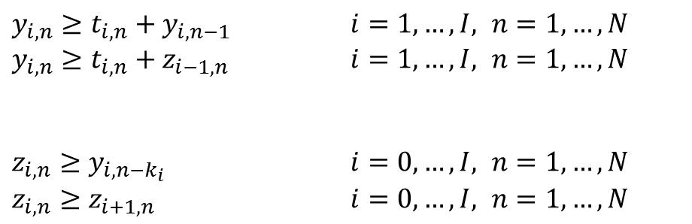
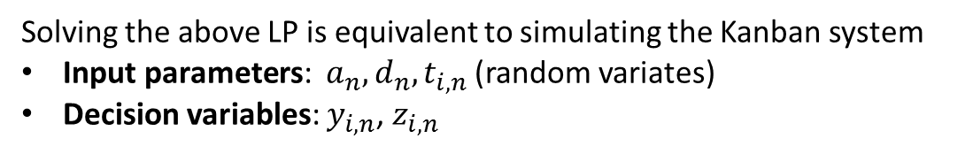

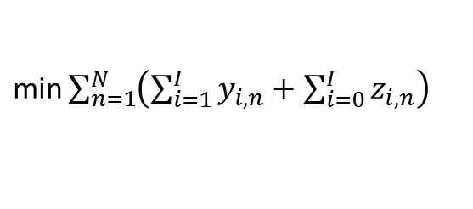
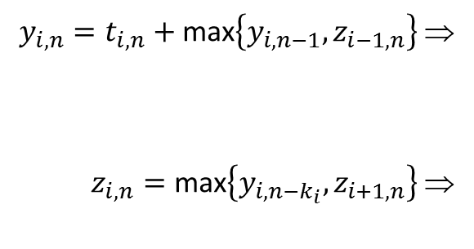
LP representation of Kanban system
LP representation of Kanban system dynamics
s.t.
$y_{0,n}=a_{n}$ $n=1,…,N$
$y_{i,n−k_{i}}=0$ $i=0,…,I, n=0,…,k_{i}$
$z_{I+1,n}=d_{n}$ $n=1,…,N$
$y_{i,n},z_{i,n}≥0$ $i=0,…,I, n=1,…,N$
$\text{min}\sum_{n=1}^{N}{\left(\sum_{i=1}^{I}{y_{i,n}}+\sum_{i=0}^{I}{z_{i,n}}\right)}$
$y_{i,n}≥t_{i,n}+y_{i,n−1}$ $i=1,…,I, n=1,…,N$
$y_{i,n}≥t_{i,n}+z_{i−1,n}$ $i=1,…,I, n=1,…,N$
$z_{i,n}≥y_{i,n−k_{i}}$ $i=0,…,I, n=1,…,N$
$z_{i,n}≥z_{i+1,n}$ $i=0,…,I, n=1,…,N$
$y_{i,n}=t_{i,n}+\text{max}\left\{y_{i,n−1},z_{i−1,n}\right\}$ ⇒
$z_{i,n}=\text{max}\left\{y_{i,n−k_{i}},z_{i+1,n}\right\}$ ⇒
Solving the above LP is equivalent to simulating the Kanban system
Input parameters: $a_{n}, d_{n},t_{i,n}$ (random variates)
Decision variables: $y_{i,n}$, $z_{i,n}$

Slide 13
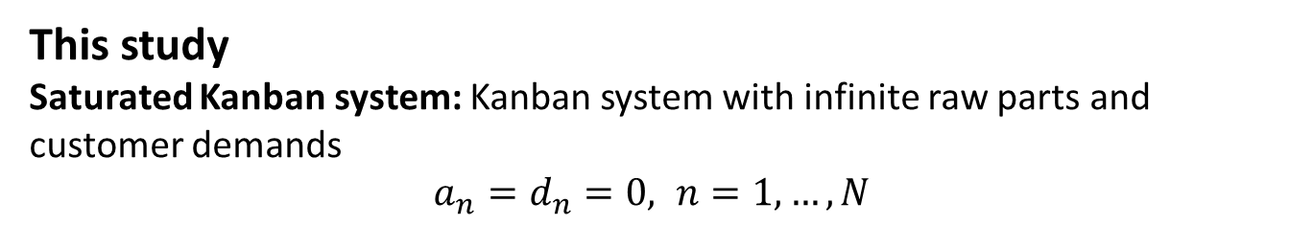
LP representation of Kanban system
This study
Saturated Kanban system: Kanban system with infinite raw parts and customer demands
$a_{n}=d_{n}=0, n=1,…,N$
The throughput of the saturated Kanban system defines the upper limit of the average customer demand rate that the regular kanban system can satisfy.

Slide 14

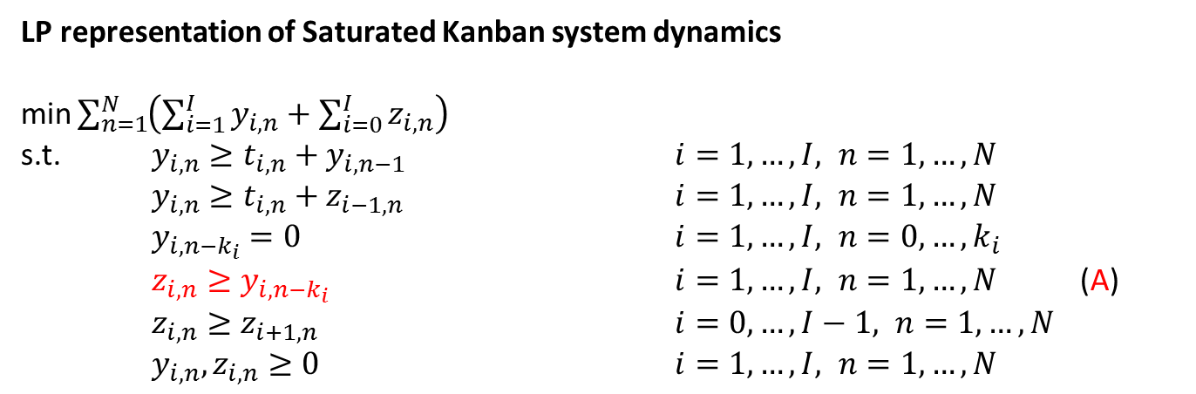
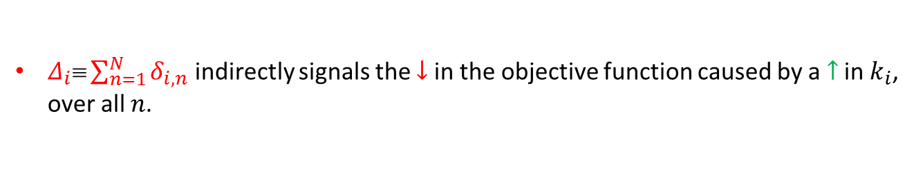
LP representation of Kanban system
LP representation of Saturated Kanban system dynamics
$\text{min}\sum_{n=1}^{N}{\left(\sum_{i=1}^{I}{y_{i,n}}+\sum_{i=0}^{I}{z_{i,n}}\right)}$
s.t. $y_{i,n}≥t_{i,n}+y_{i,n−1}$ $i=1,…,I, n=1,…,N$
$y_{i,n}≥t_{i,n}+z_{i−1,n}$ $i=1,…,I, n=1,…,N$
$y_{i,n−k_{i}}=0$ $i=1,…,I, n=0,…,k_{i}$
$z_{i,n}≥y_{i,n−k_{i}}$ $i=1,…,I, n=1,…,N$ (A) $z_{i,n}≥z_{i+1,n}$ $i=0,…,I−1, n=1,…,N$
$y_{i,n},z_{i,n}≥0$ $i=1,…,I, n=1,…,N$
(shadow price)
$\left(δ_{i,n}\right)$
$k_{i}↑  y_{i,n−k_{i}}↓$ obj. fun $↓$ $$ throughput $↑$
$δ_{i,n} $ marginal $↓$ in the objective function, if the rhs of (A) is slightly $↓$.
Rhs of (A) $↓$, if ${k_{i}↑ δ}_{i,n}$ indirectly signals the $↓$in the objective function caused by a $↑$ in $k_{i}$, assuming that this $↑$affects only $y_{i,n−k_{i}}$ (for the specific value of $n$).
$Δ_{i}≡\sum_{n=1}^{N}{δ_{i,n}}$ indirectly signals the $↓$in the objective function caused by a $↑$ in $k_{i}$, over all $n$.

Slide 15
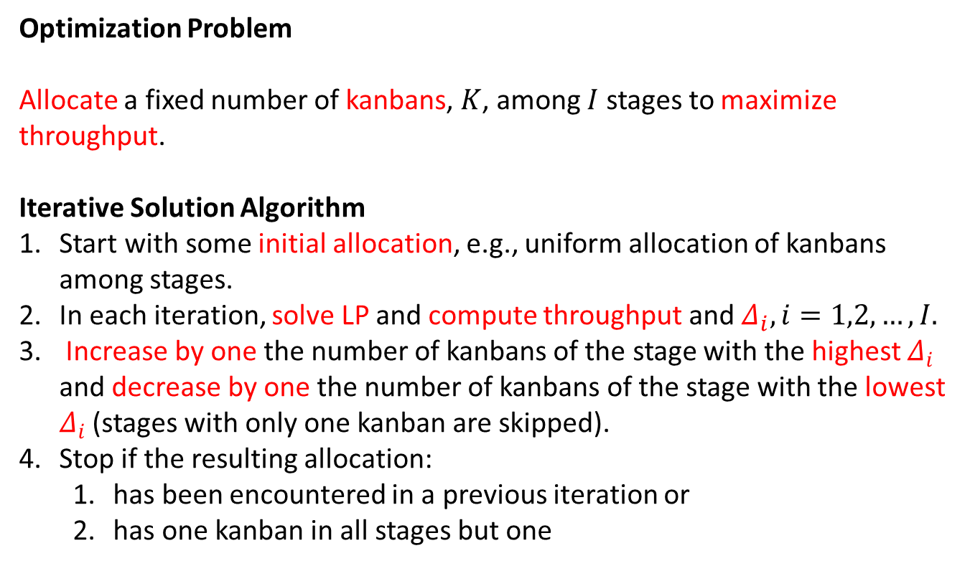
LP representation of Kanban system
Optimization Problem
Allocate a fixed number of kanbans, $K$, among $I$ stages to maximize throughput.
Iterative Solution Algorithm
Start with some initial allocation, e.g., uniform allocation of kanbans among stages.
In each iteration, solve LP and compute throughput and $Δ_{i},i=1,2,…,I.$
Increase by one the number of kanbans of the stage with the highest $Δ_{i}$ and decrease by one the number of kanbans of the stage with the lowest $Δ_{i}$ (stages with only one kanban are skipped).
Stop if the resulting allocation:
  has been encountered in a previous iteration or
  has one kanban in all stages but one

Slide 16
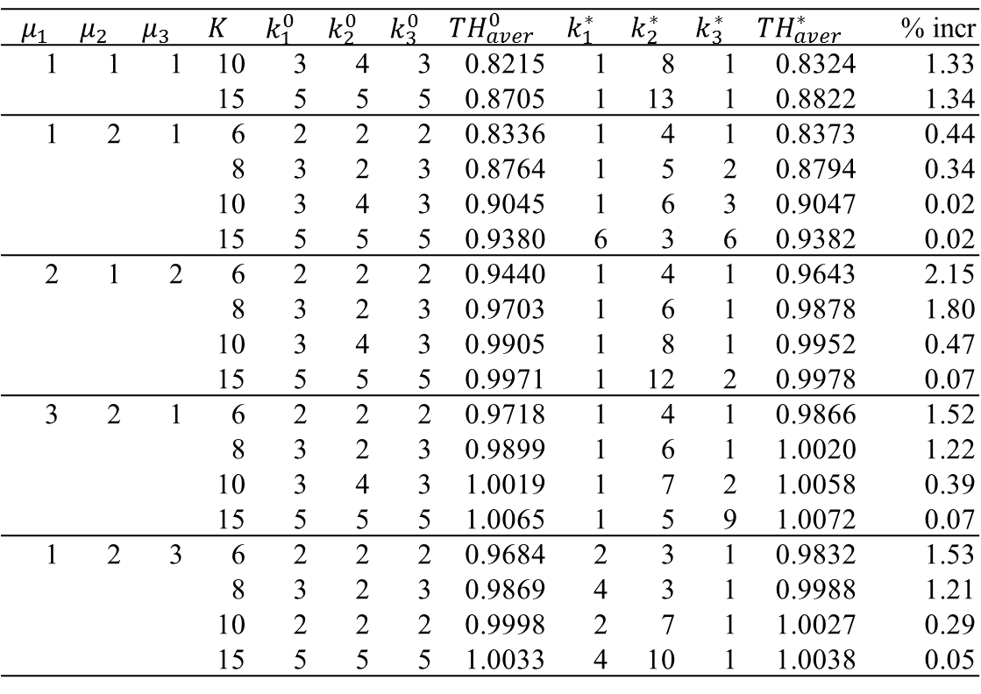
Numerical Results
Table 2. Results for the 3-stage kanban system (N = 60,000).
$$μ_{1}$$ | $$μ_{2}$$ | $$μ_{3}$$ | $$K$$ | $$k_{1}^{0}$$ | $$k_{2}^{0}$$ | $$k_{3}^{0}$$ | $${TH}_{aver}^{0}$$ | $$k_{1}^{∗}$$ | $$k_{2}^{∗}$$ | $$k_{3}^{∗}$$ | $${TH}_{aver}^{∗}$$ | % incr
1 | 1 | 1 | 10 | 3 | 4 | 3 | 0.8215 | 1 | 8 | 1 | 0.8324 | 1.33
 |  |  | 15 | 5 | 5 | 5 | 0.8705 | 1 | 13 | 1 | 0.8822 | 1.34
1 | 2 | 1 | 6 | 2 | 2 | 2 | 0.8336 | 1 | 4 | 1 | 0.8373 | 0.44
 |  |  | 8 | 3 | 2 | 3 | 0.8764 | 1 | 5 | 2 | 0.8794 | 0.34
 |  |  | 10 | 3 | 4 | 3 | 0.9045 | 1 | 6 | 3 | 0.9047 | 0.02
 |  |  | 15 | 5 | 5 | 5 | 0.9380 | 6 | 3 | 6 | 0.9382 | 0.02
2 | 1 | 2 | 6 | 2 | 2 | 2 | 0.9440 | 1 | 4 | 1 | 0.9643 | 2.15
 |  |  | 8 | 3 | 2 | 3 | 0.9703 | 1 | 6 | 1 | 0.9878 | 1.80
 |  |  | 10 | 3 | 4 | 3 | 0.9905 | 1 | 8 | 1 | 0.9952 | 0.47
 |  |  | 15 | 5 | 5 | 5 | 0.9971 | 1 | 12 | 2 | 0.9978 | 0.07
3 | 2 | 1 | 6 | 2 | 2 | 2 | 0.9718 | 1 | 4 | 1 | 0.9866 | 1.52
 |  |  | 8 | 3 | 2 | 3 | 0.9899 | 1 | 6 | 1 | 1.0020 | 1.22
 |  |  | 10 | 3 | 4 | 3 | 1.0019 | 1 | 7 | 2 | 1.0058 | 0.39
 |  |  | 15 | 5 | 5 | 5 | 1.0065 | 1 | 5 | 9 | 1.0072 | 0.07
1 | 2 | 3 | 6 | 2 | 2 | 2 | 0.9684 | 2 | 3 | 1 | 0.9832 | 1.53
 |  |  | 8 | 3 | 2 | 3 | 0.9869 | 4 | 3 | 1 | 0.9988 | 1.21
 |  |  | 10 | 2 | 2 | 2 | 0.9998 | 2 | 7 | 1 | 1.0027 | 0.29
 |  |  | 15 | 5 | 5 | 5 | 1.0033 | 4 | 10 | 1 | 1.0038 | 0.05

Slide 17
Numerical Results
Figure 3. Plots of $μ_{i}$ and $k_{i}^{∗}$ vs. $i$ for the 3-stage kanban system ($N$ = 60,000).

Slide 18
Numerical Results
Figure 3. Plots of $μ_{i}$ and $k_{i}^{∗}$ vs. $i$ for the 3-stage kanban system ($N$ = 60,000).

Slide 19
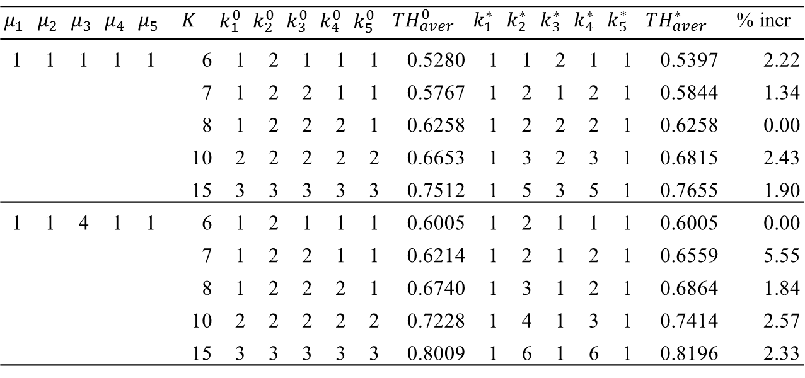
Numerical Results
Table 3. Results for the 5-stage kanban system (N = 50,000).
$$μ_{1}$$ | $$μ_{2}$$ | $$μ_{3}$$ | $$μ_{4}$$ | $$μ_{5}$$ | $$K$$ | $$k_{1}^{0}$$ | $$k_{2}^{0}$$ | $$k_{3}^{0}$$ | $$k_{4}^{0}$$ | $$k_{5}^{0}$$ | $${TH}_{aver}^{0}$$ | $$k_{1}^{∗}$$ | $$k_{2}^{∗}$$ | $$k_{3}^{∗}$$ | $$k_{4}^{∗}$$ | $$k_{5}^{∗}$$ | $${TH}_{aver}^{∗}$$ | % incr
1 | 1 | 1 | 1 | 1 | 6 | 1 | 2 | 1 | 1 | 1 | 0.5280 | 1 | 1 | 2 | 1 | 1 | 0.5397 | 2.22
 |  |  |  |  | 7 | 1 | 2 | 2 | 1 | 1 | 0.5767 | 1 | 2 | 1 | 2 | 1 | 0.5844 | 1.34
 |  |  |  |  | 8 | 1 | 2 | 2 | 2 | 1 | 0.6258 | 1 | 2 | 2 | 2 | 1 | 0.6258 | 0.00
 |  |  |  |  | 10 | 2 | 2 | 2 | 2 | 2 | 0.6653 | 1 | 3 | 2 | 3 | 1 | 0.6815 | 2.43
 |  |  |  |  | 15 | 3 | 3 | 3 | 3 | 3 | 0.7512 | 1 | 5 | 3 | 5 | 1 | 0.7655 | 1.90
1 | 1 | 4 | 1 | 1 | 6 | 1 | 2 | 1 | 1 | 1 | 0.6005 | 1 | 2 | 1 | 1 | 1 | 0.6005 | 0.00
 |  |  |  |  | 7 | 1 | 2 | 2 | 1 | 1 | 0.6214 | 1 | 2 | 1 | 2 | 1 | 0.6559 | 5.55
 |  |  |  |  | 8 | 1 | 2 | 2 | 2 | 1 | 0.6740 | 1 | 3 | 1 | 2 | 1 | 0.6864 | 1.84
 |  |  |  |  | 10 | 2 | 2 | 2 | 2 | 2 | 0.7228 | 1 | 4 | 1 | 3 | 1 | 0.7414 | 2.57
 |  |  |  |  | 15 | 3 | 3 | 3 | 3 | 3 | 0.8009 | 1 | 6 | 1 | 6 | 1 | 0.8196 | 2.33

Slide 20
Numerical Results
Figure 4. Plots of $μ_{i}$ and $k_{i}^{∗}$ vs. $i$ for the 5-stage kanban system ($N$ = 50,000).

Slide 21
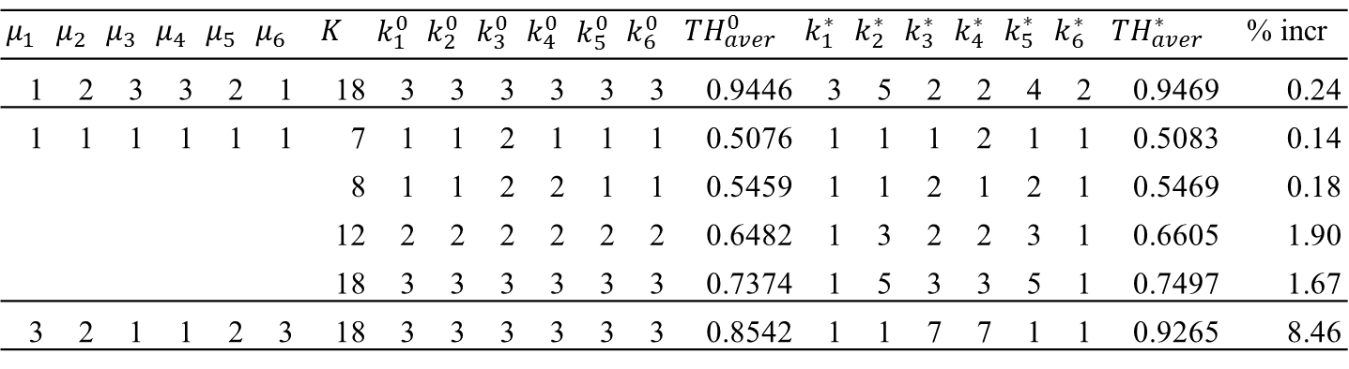
Numerical Results
Table 4. Results for the 6-stage kanban system (N = 30,000).
$$μ_{1}$$ | $$μ_{2}$$ | $$μ_{3}$$ | $$μ_{4}$$ | $$μ_{5}$$ | $$μ_{6}$$ | $$K$$ | $$k_{1}^{0}$$ | $$k_{2}^{0}$$ | $$k_{3}^{0}$$ | $$k_{4}^{0}$$ | $$k_{5}^{0}$$ | $$k_{6}^{0}$$ | $${TH}_{aver}^{0}$$ | $$k_{1}^{∗}$$ | $$k_{2}^{∗}$$ | $$k_{3}^{∗}$$ | $$k_{4}^{∗}$$ | $$k_{5}^{∗}$$ | $$k_{6}^{∗}$$ | $${TH}_{aver}^{∗}$$ | % incr
1 | 2 | 3 | 3 | 2 | 1 | 18 | 3 | 3 | 3 | 3 | 3 | 3 | 0.9446 | 3 | 5 | 2 | 2 | 4 | 2 | 0.9469 | 0.24
1 | 1 | 1 | 1 | 1 | 1 | 7 | 1 | 1 | 2 | 1 | 1 | 1 | 0.5076 | 1 | 1 | 1 | 2 | 1 | 1 | 0.5083 | 0.14
 |  |  |  |  |  | 8 | 1 | 1 | 2 | 2 | 1 | 1 | 0.5459 | 1 | 1 | 2 | 1 | 2 | 1 | 0.5469 | 0.18
 |  |  |  |  |  | 12 | 2 | 2 | 2 | 2 | 2 | 2 | 0.6482 | 1 | 3 | 2 | 2 | 3 | 1 | 0.6605 | 1.90
 |  |  |  |  |  | 18 | 3 | 3 | 3 | 3 | 3 | 3 | 0.7374 | 1 | 5 | 3 | 3 | 5 | 1 | 0.7497 | 1.67
3 | 2 | 1 | 1 | 2 | 3 | 18 | 3 | 3 | 3 | 3 | 3 | 3 | 0.8542 | 1 | 1 | 7 | 7 | 1 | 1 | 0.9265 | 8.46

Slide 22
Numerical Results
Figure 5. Plots of $μ_{i}$ and $k_{i}^{∗}$ vs. $i$ for the 6-stage kanban system ($N$ = 30,000).

Slide 23
Numerical Results
Table 5. Results for the 10-stage kanban system (N = 10,000).
$$μ_{1}$$ | $$μ_{2}$$ | $$μ_{3}$$ | $$μ_{4}$$ | $$μ_{5}$$ | $$μ_{6}$$ | $$μ_{7}$$ | $$μ_{8}$$ | $$μ_{9}$$ | $$μ_{10}$$ | $$K$$ | $$k_{1}^{0}$$ | $$k_{2}^{0}$$ | $$k_{3}^{0}$$ | $$k_{4}^{0}$$ | $$k_{5}^{0}$$ | $$k_{6}^{0}$$ | $$k_{7}^{0}$$ | $$k_{8}^{0}$$ | $$k_{9}^{0}$$ | $$k_{10}^{0}$$ | $${TH}_{aver}^{0}$$ | $$k_{1}^{∗}$$ | $$k_{2}^{∗}$$ | $$k_{3}^{∗}$$ | $$k_{4}^{∗}$$ | $$k_{5}^{∗}$$ | $$k_{6}^{∗}$$ | $$k_{7}^{∗}$$ | $$k_{8}^{∗}$$ | $$k_{9}^{∗}$$ | $$k_{10}^{∗}$$ | $${TH}_{aver}^{∗}$$ | % incr
1 | 1 | 1 | 1 | 1 | 1 | 1 | 1 | 1 | 1 | 12 | 1 | 1 | 1 | 1 | 2 | 2 | 1 | 1 | 1 | 1 | 0.4692 | 1 | 1 | 1 | 2 | 1 | 1 | 2 | 1 | 1 | 1 | 0.4765 | 1.56
Figure 5. Plots of $μ_{i}$ and $k_{i}^{∗}$ vs. $i$ for the 10-stage kanban system ($N$ = 10,000).

Slide 24
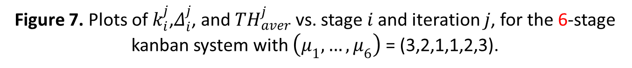
Numerical Results
Figure 7. Plots of $k_{i}^{j}$,$Δ_{i}^{j}$, and ${TH}_{aver}^{j}$ vs. stage $i$ and iteration $j$, for the 6-stage kanban system with $\left(μ_{1},…,μ_{6}\right)$ = (3,2,1,1,2,3).

Slide 25
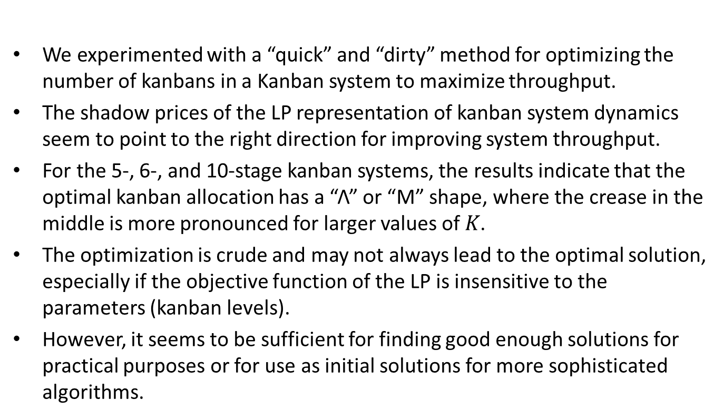
Conclusions
We experimented with a “quick” and “dirty” method for optimizing the number of kanbans in a Kanban system to maximize throughput.
The shadow prices of the LP representation of kanban system dynamics seem to point to the right direction for improving system throughput.
For the 5-, 6-, and 10-stage kanban systems, the results indicate that the optimal kanban allocation has a “Λ” or “M” shape, where the crease in the middle is more pronounced for larger values of $K$.
The optimization is crude and may not always lead to the optimal solution, especially if the objective function of the LP is insensitive to the parameters (kanban levels).
However, it seems to be sufficient for finding good enough solutions for practical purposes or for use as initial solutions for more sophisticated algorithms.

Slide 26
Acknowledgement
This work was supported by grant MIS 379526 “Odysseus: A holistic approach for managing variability in contemporary global supply chain networks,” which was co-financed by the European Union (European Social Fund - ESF) and Greek national funds through the Operational Program “Education and Lifelong Learning” of the National Strategic Reference Framework (NSRF) - Research Funding Program: THALES: Reinforcement of the interdisciplinary and/or inter-institutional research and innovation.

Slide 27
Thank you for your patience.
Any questions?

